Slide 1
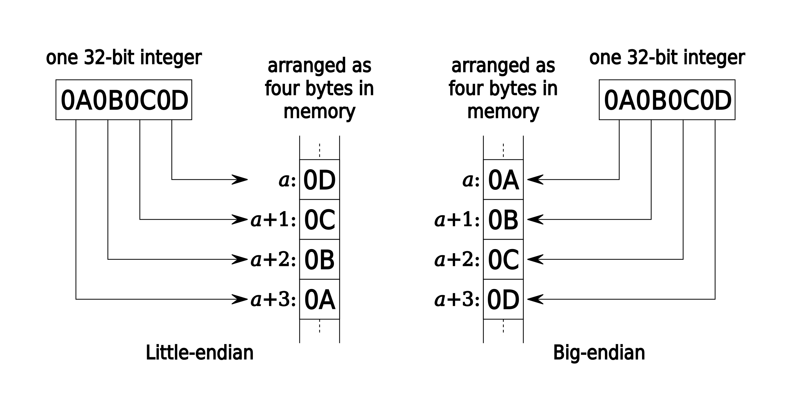
By Aeroid - Own work, CC BY-SA 4.0, https://commons.wikimedia.org/w/index.php?curid=137790829

